Slide 1
Observer Pattern

Slide 2
Why I chose to talk about this
I based most of this presentation around the question “Which design pattern would be the best for my working style and the technologies I use?”

Slide 3
OVERVIEW
The Observer Design Pattern is a behavioural design pattern that establishes a one-to-many relationship between objects.
It allows an object to maintain a list of its dependents and automatically notify them of any state changes, usually by calling one of their methods.
Commonly used in event-driven systems, such as user interface frameworks, where changes in one part of the system need to be reflected in others

Slide 4
Subjects & Observers
SUBJECT
OBSERVER
Maintains a list of observers and notifies them of any state changes.
When the state changes, it calls the update method on each of its observers to notify them of the change.
Defines an update method that is called when the subject’s state changes.
Each observer implements the update method to handle the notification and react accordingly.

Slide 5
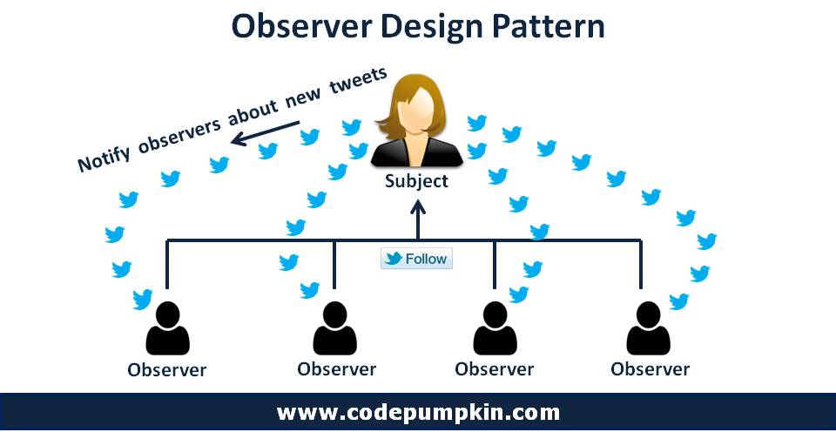

Slide 6
References
betterprogramming.pub/understanding-the-observer-design-pattern-f621b1d0b6c9
en.wikipedia.org/wiki/Observer_pattern
www.sitepoint.com/understanding-the-observer-pattern
codepumpkin.com

Slide 7
Cheers

